Slide 1
How to create a search profile slot
In Primo VE NDE
Yoel Kortick | May 2026

Slide 2
Introduction
What is a search scope?
What is a search profile?
What is a search profile slot?
Configuring a new search profile and search scope - example 1
Configuring a new search profile and search scope - example 2
Configuring a new search profile and search scope - example 3
Adding a search profile slot to a Primo View
Adding a search profile slot to a Primo View - example 1
Adding a search profile slot to a Primo View - example 2
Adding a search profile slot to a Primo View - example 3
Testing the new search profile slots
Agenda

Slide 3

Introduction

Slide 4
Introduction
In the example here we will create three new search profile slots and then add them to the Primo View called “Alma”.
The three new search profile slots which we will add are:
  Records about Taiwan
  Records available electronically
  Records in the Library and Information Science Library
See also Configuring Discovery Views for Primo VE, particularly the section Adding a Search Profile Slot.

Slide 5
Introduction
Before we get into the details of the search profile slot, we will discuss three interrelated components and see both:
  How they are defined
  How they relate to each other

Slide 6
Introduction
The “Primo View” contains one or more “Search profile slots”
The “Search profile slot” contains one or more “Search profiles”
The “Search profile” contains one or more “Scopes”
This is visually explained on the next slide.

Slide 7
Introduction
Primo View
Search Profile Slot
Search Profile Slot
Search Profile
Search Profile
Search Profile
Search Profile
Scope
Scope
Scope
Scope
Scope
Scope
Scope
Scope

Slide 8
What is a search scope?

Slide 9
What is a search scope?
A search scope can be
  Based on predefined values such as libraries, campuses, central index, or the entire institution
  A Custom Local Data Scope based on specific bibliographic metadata or inventory
It defines a group of records to later be included in the search profile

Slide 10
What is a search profile?

Slide 11
What is a search profile?
See also Configuring Search Profiles .
A search profile contains scopes
Search profiles allow the institution to define groups of records that meet specific conditions.
The purpose of this is to allow end users in discovery to search and quickly find specific materials and services offered by the institution.
For example, these groups may contain records that belong to a specific library, or perhaps have a specific resource type.

Slide 12
What is a search profile?
Out-of-the box, Primo VE provides the following search profiles:
  CentralIndex (Articles and more) – Searches within this profile include collections from the Central Discovery Index (CDI).
  CourseReserves (Course Reserves) – Searches within this profile include all records that are linked to an active course. By default, this profile is inactive in a view's definition.
  MyInst_and_CI (Search everything) – Searches within this profile include all resources that belong to your institution and all collections from the Central index.
  MyInstitution (Library Catalog) – Searches within this profile include all resources that belong to your institution.

Slide 13
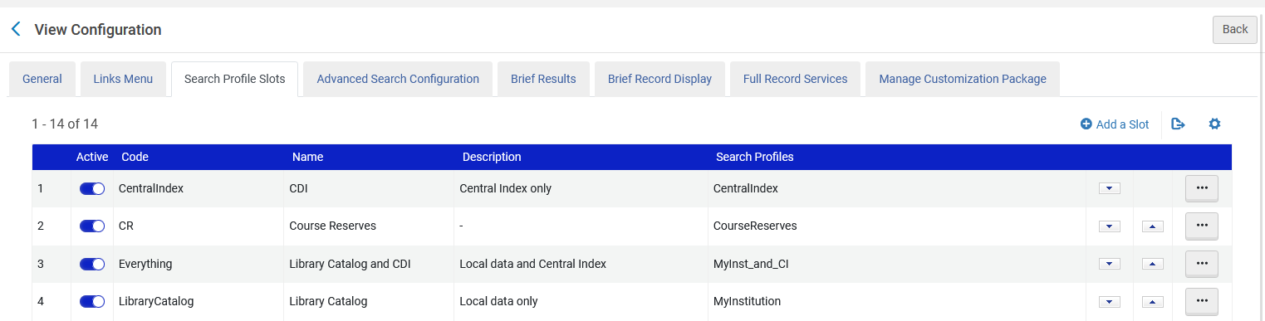
What is a search profile?
Out-of-the box, Primo VE provides the following search profiles:

Slide 14
What is a search profile slot?

Slide 15
What is a search profile slot?
Search profile slots
  Enable end users in discovery to narrow searches to material under specific categories (such as the full catalog, journals, or items from a specific campus only).
  Are defined at "Configuration Menu > Discovery > Display Configuration > Configure Views > Edit View > switch to tab Search Profile Slots"
  Contain one or more activated search profiles .

Slide 16
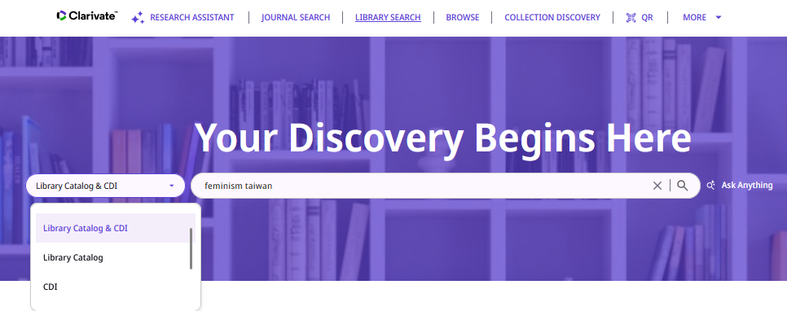
What is a search profile slot?
The Search Profile Slots appear when performing a search:

Slide 17
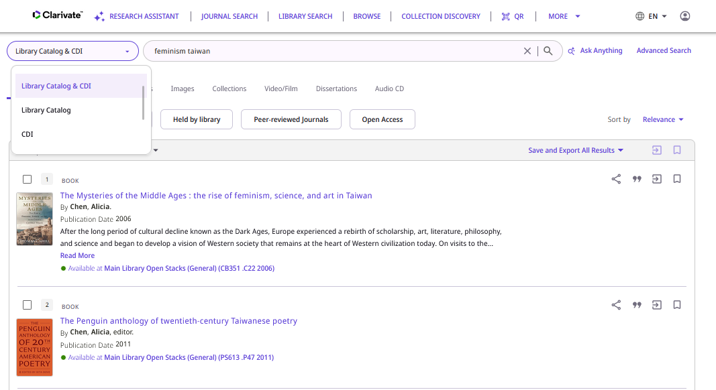
What is a search profile slot?
The Search Profile Slots also appear next to the search box on the Results List page

Slide 18
Configuring a new search profile and search scope - example 1

Slide 19
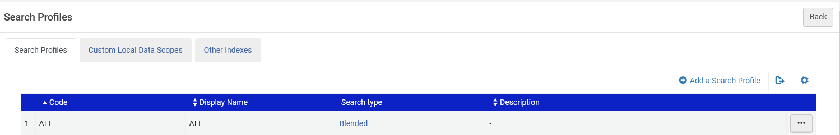
Configuring a new search profile and search scope - example 1
To configure a search scope, go to “Configuration > Discovery > Search Configuration > Search Profiles”
Then either add a new search profile or edit an existing search profile.
We could now from the “Search Profiles” tab add a new search profile

Slide 20
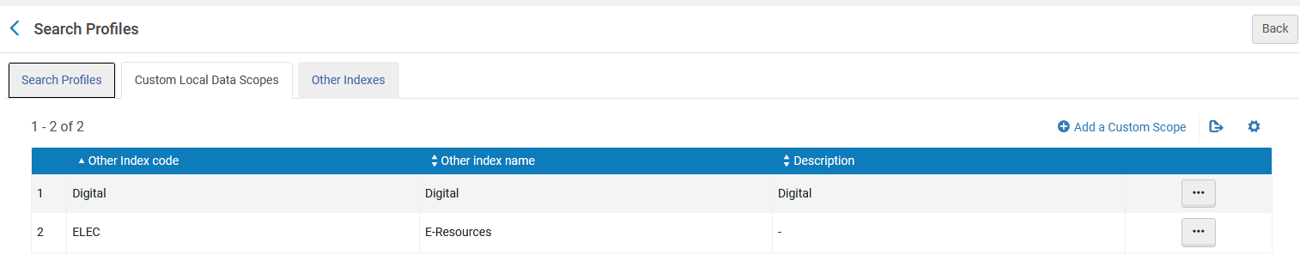
Configuring a new search profile and search scope - example 1
However, will not yet add a new search profile because we want to first define a local data scope of all records with word from subject “Taiwan”
Therefore, we will first go to tab “Custom Local Data Scopes” and click “Add Custom Scope”

Slide 21
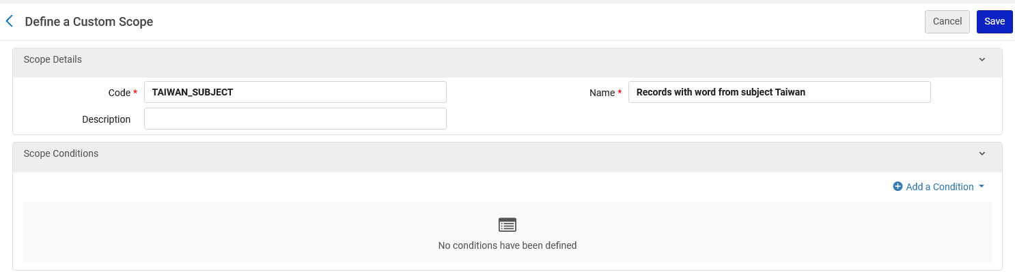
Configuring a new search profile and search scope - example 1
Here we have defined:
  Search profile code = TAIWAN_SUBJECT
  Search profile display name = Records with word from subject Taiwan
Now we will click “Add a Condition”

Slide 22
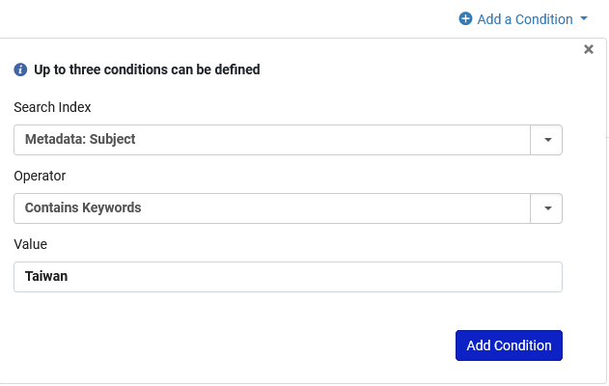
Configuring a new search profile and search scope - example 1
After clicking “Add a Condition” we have filled in as follows:
  Search Index: Metadata: Subject
  Operator: Contains Keywords
  Value: Taiwan
Now we will click “Add a Condition”

Slide 23
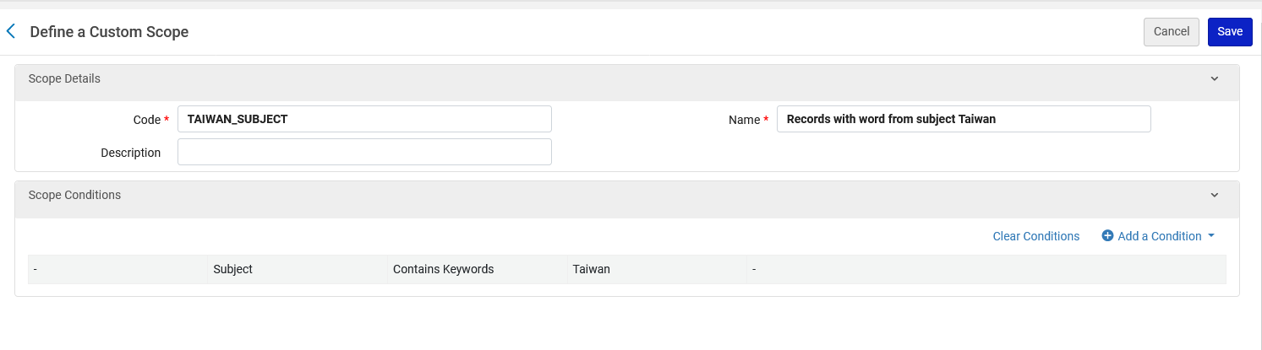
Configuring a new search profile and search scope - example 1
The custom scope has been defined, and we will click “Save”

Slide 24
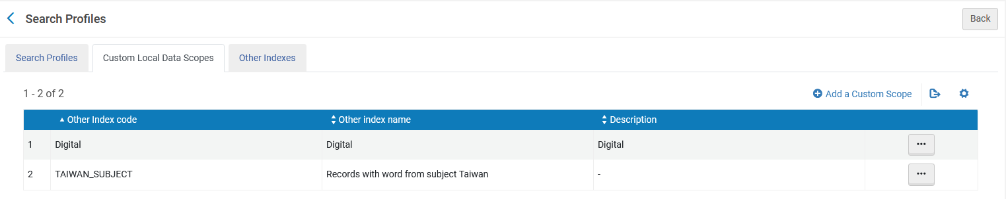
Configuring a new search profile and search scope - example 1
Here is the new custom local data scope

Slide 25
Configuring a new search profile and search scope - example 1
Now we return the “Search Profiles” tab and add a search profile

Slide 26
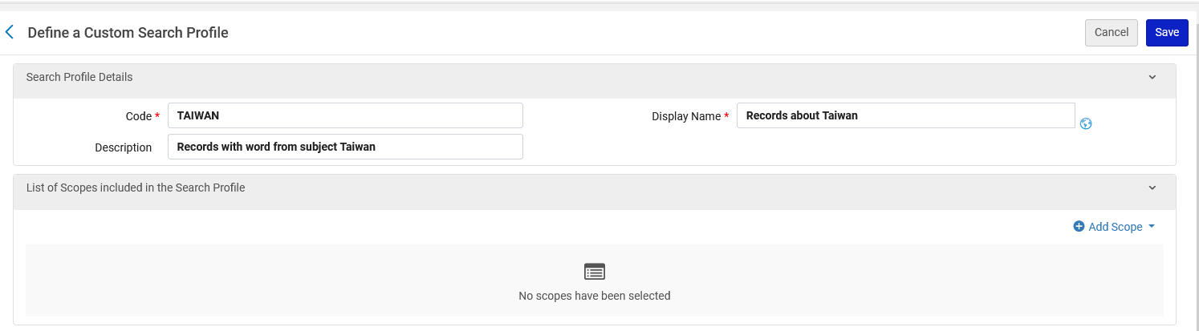
Configuring a new search profile and search scope - example 1
Here we have defined:
  Search profile code = TAIWAN
  Search profile display name = Records about Taiwan
  Search profile description = Records with word from subject Taiwan
Now we will click “Add Scope”

Slide 27
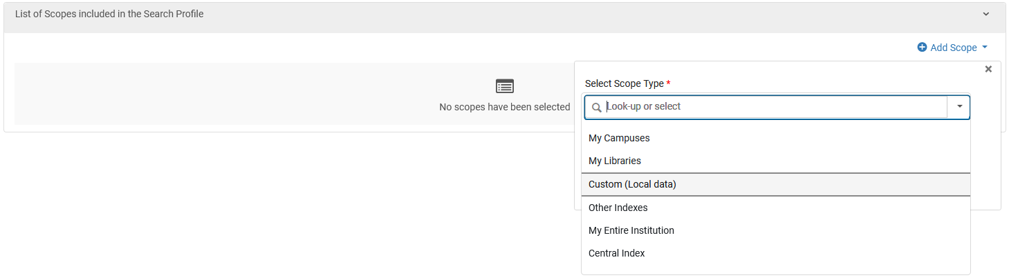
Configuring a new search profile and search scope - example 1
After clicking add scope we will choose “Scope Type” as “Custom (Local Data)” because this will allow us to use the custom local data scope which we just now created.

Slide 28
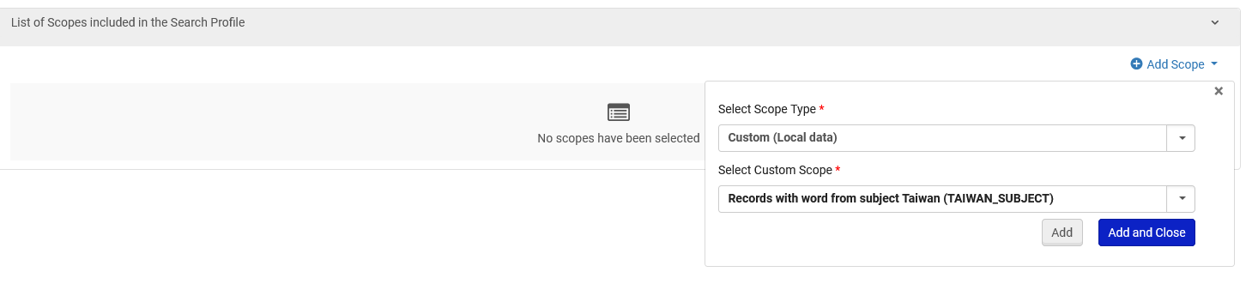
Configuring a new search profile and search scope - example 1
For the “Select Custom Scope” we will choose the custom scope we created “Records with word from subject Taiwan”
Click “Add and Close”

Slide 29
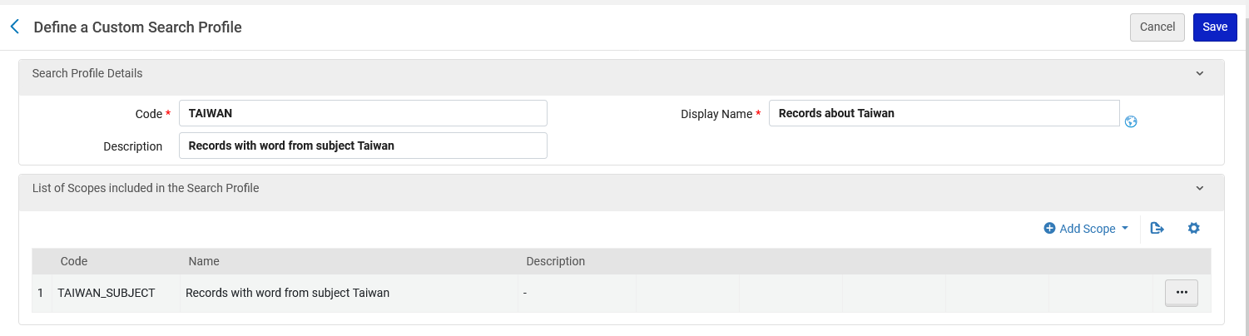
Configuring a new search profile and search scope - example 1
Now we will save the custom search profile

Slide 30
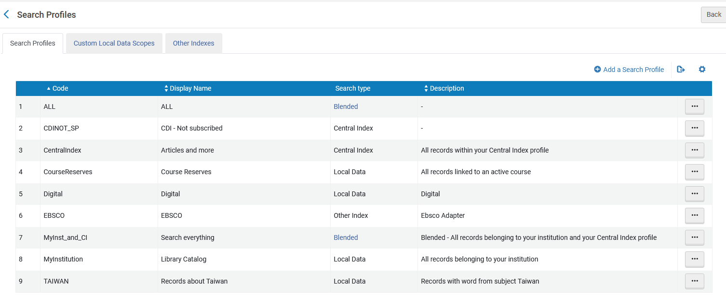
Configuring a new search profile and search scope - example 1
The new custom search profile has been saved

Slide 31
Configuring a new search profile and search scope - example 2

Slide 32
Configuring a new search profile and search scope - example 2
To configure a search scope, go to “Configuration > Discovery > Search Configuration > Search Profiles”
Then either add a new search profile or edit an existing search profile.
We could now from the “Search Profiles” tab add a new search profile

Slide 33
Configuring a new search profile and search scope - example 2
However, we want to first define a local data scope of all records with word electronic availability”
Therefore, we will first go to tab “Custom Local Data Scopes” and click “Add Custom Scope”

Slide 34
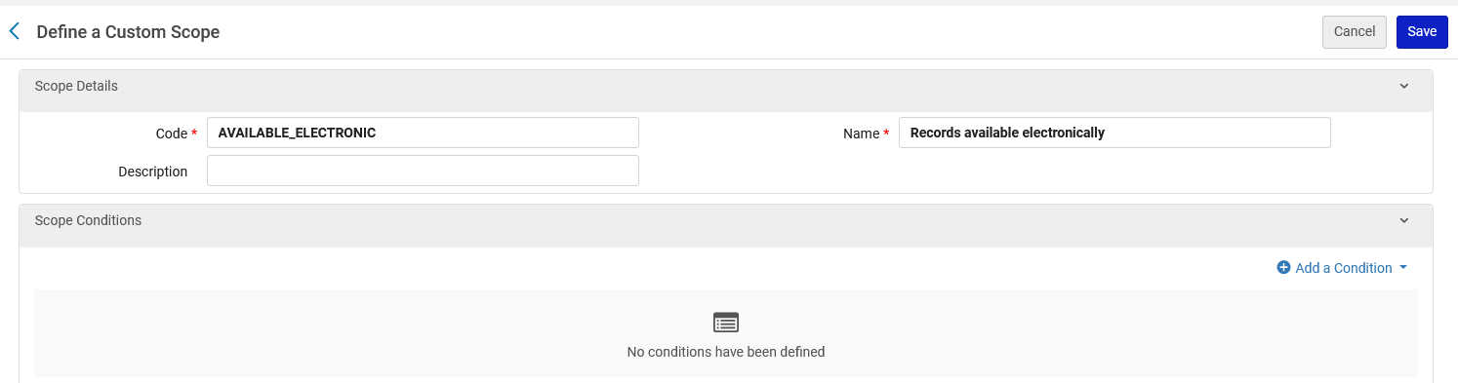
Configuring a new search profile and search scope - example 2
Here we have defined:
  Search profile code = AVAILABLE_ELECTRONIC
  Search profile display name = Records available electronically
Now we will click “Add a Condition”

Slide 35
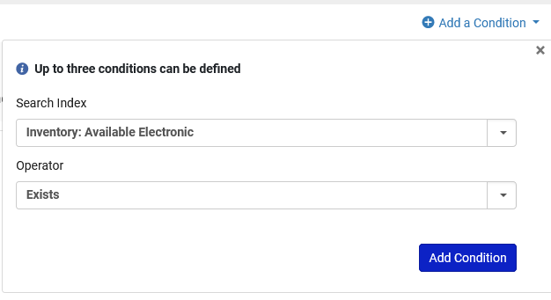
Configuring a new search profile and search scope - example 2
After clicking “Add a Condition” we have filled in as follows:
  Search Index: Available Electronic
  Operator: Exists
Now we will click “Add a Condition”

Slide 36
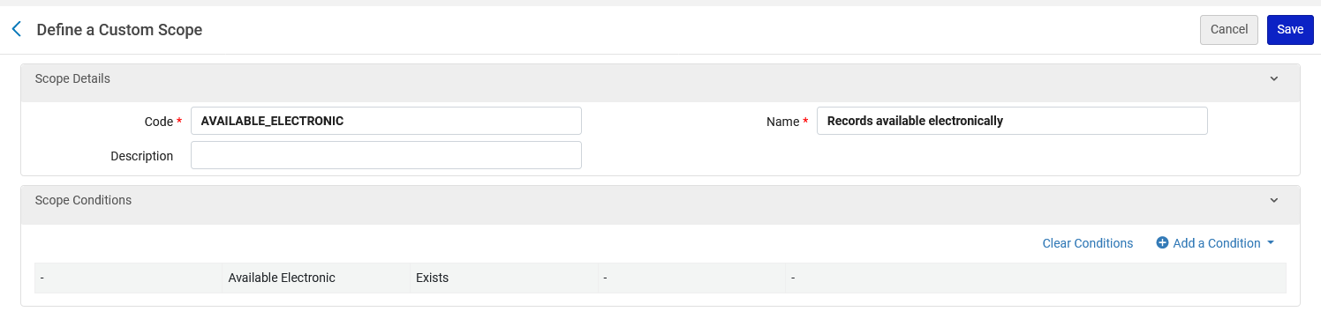
Configuring a new search profile and search scope - example 2
The custom scope has been defined, and we will click “Save”

Slide 37
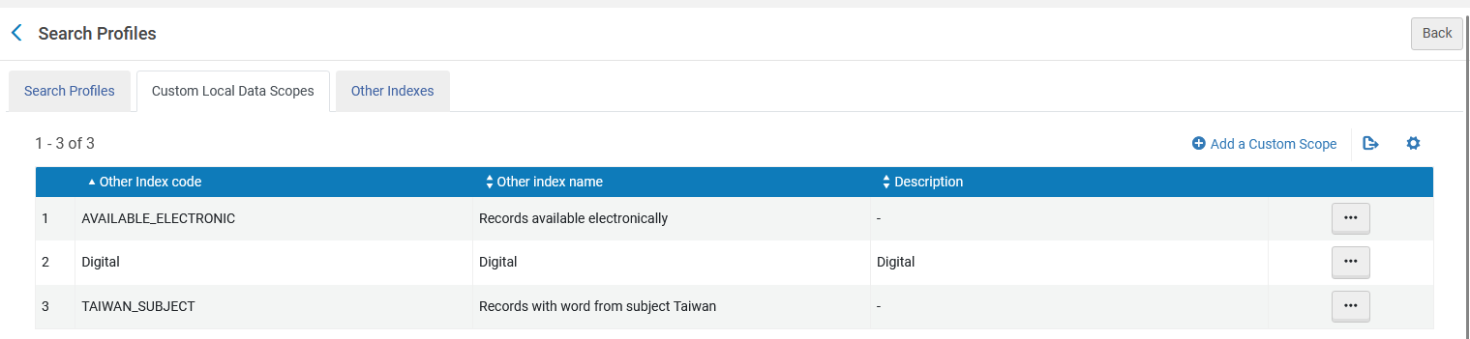
Configuring a new search profile and search scope - example 2
Here is the new custom local data scope

Slide 38
Configuring a new search profile and search scope - example 2
Now we return the “Search Profiles” tab and add a search profile

Slide 39
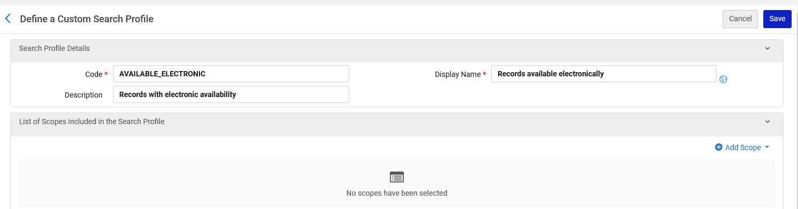
Configuring a new search profile and search scope - example 2
Here we have defined:
  Search profile code = AVAILABLE_ELECTRONIC
  Search profile display name = Records available electronically
  Search profile description = Records with electronic availability
Now we will click “Add Scope”

Slide 40
Configuring a new search profile and search scope - example 2
After clicking add scope we will choose “Scope Type” as “Custom Local Data” because this will allow us to use the custom local data scope which we just now created.

Slide 41
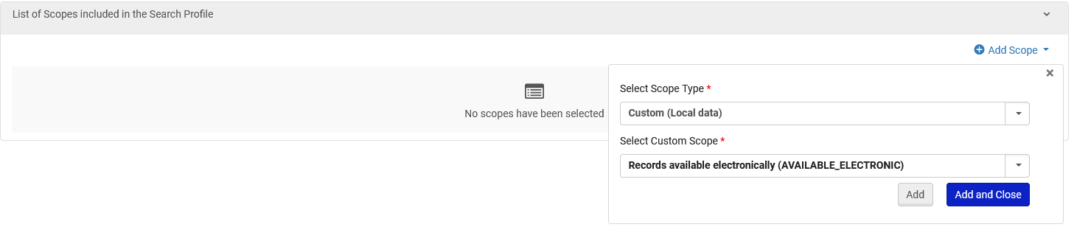
Configuring a new search profile and search scope - example 2
For the “Select Custom Scope” we will choose the custom scope we created “Records available electronically”
Click “Add and Close”

Slide 42
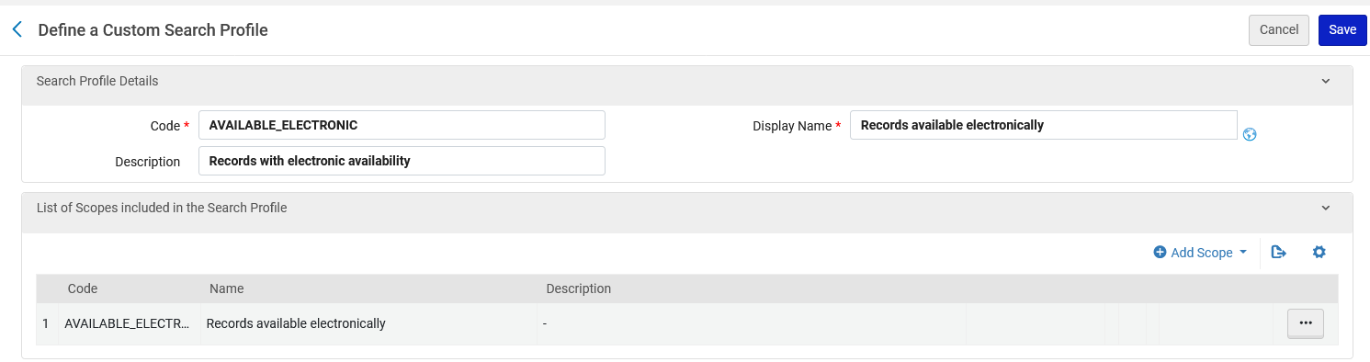
Configuring a new search profile and search scope - example 2
Now we will save the custom search profile

Slide 43
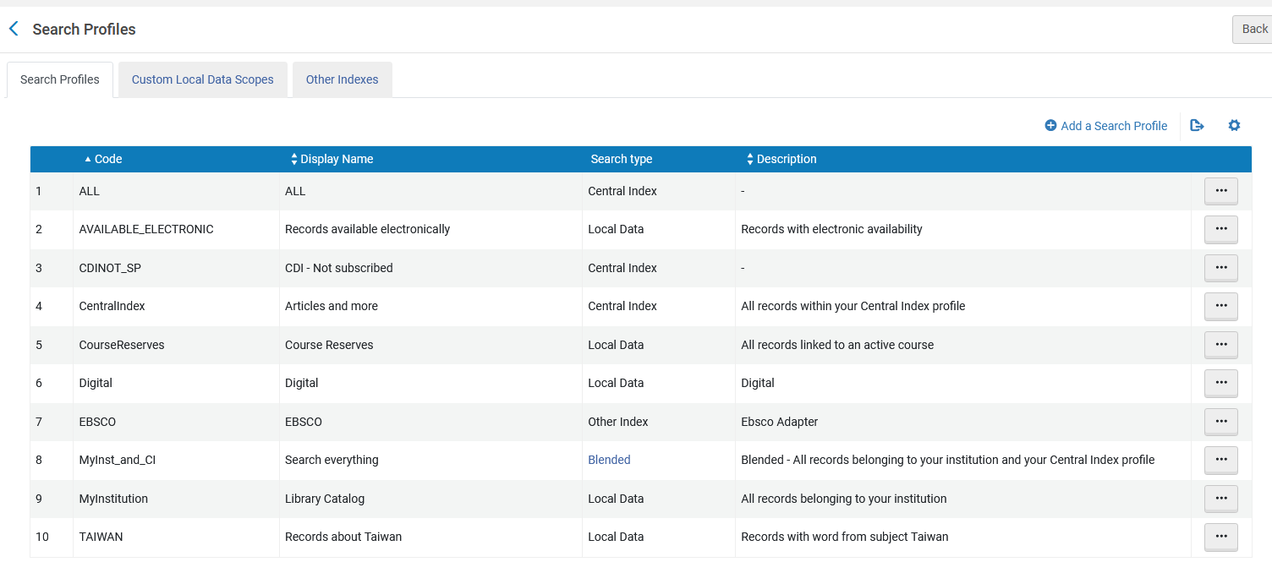
Configuring a new search profile and search scope - example 2
The new custom search profile has been saved

Slide 44
Configuring a new search profile and search scope - example 3

Slide 45
Configuring a new search profile and search scope - example 3
To configure a search scope, go to “Configuration > Discovery > Search Configuration > Search Profiles”
Then either add a new search profile or edit an existing search profile.
We will now from the “Search Profiles” tab add a new search profile

Slide 46
Configuring a new search profile and search scope - example 3
From the “Search Profiles” tab we add a search profile

Slide 47
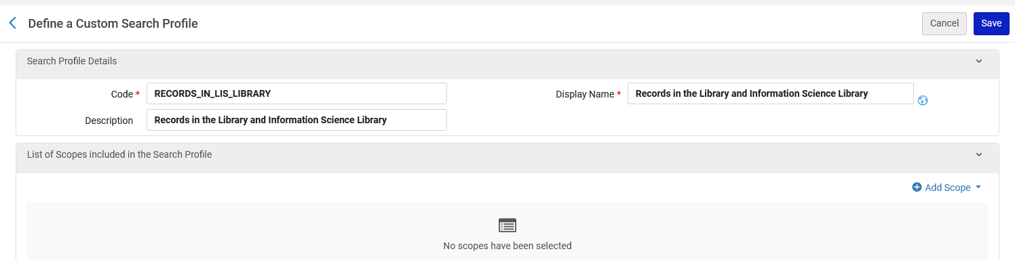
Configuring a new search profile and search scope - example 3
Here we have defined:
  Search profile code = RECORDS_IN_LIS_LIBRARY
  Search profile display name = Records in the Library and Information Science Library
  Search profile description = Records in the Library and Information Science Library
Now we will click “Add Scope”

Slide 48
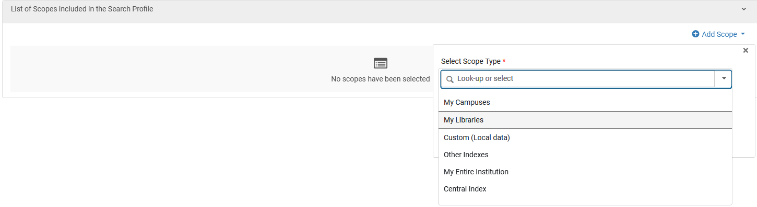
Configuring a new search profile and search scope - example 3
After clicking add scope we will choose “Scope Type” as “My Libraries” because this will allow us to use the “Library and Information Science Library” as a parameter

Slide 49
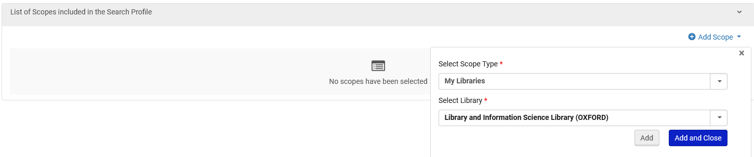
Configuring a new search profile and search scope - example 3
In the field “Select Library” we have chosen “Library and Information Science Library”
Click “Add and Close”

Slide 50
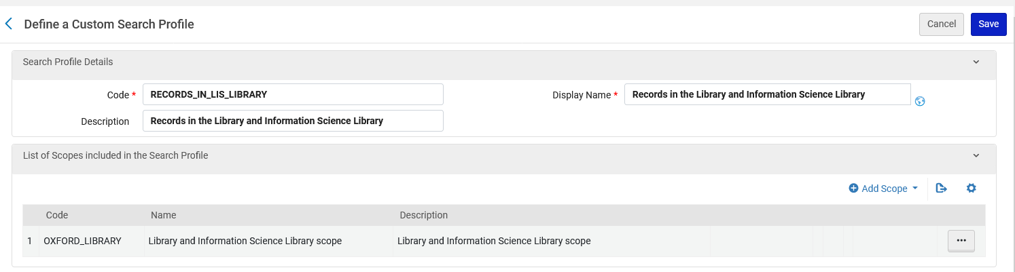
Configuring a new search profile and search scope - example 3
Now we will save the custom search profile

Slide 51
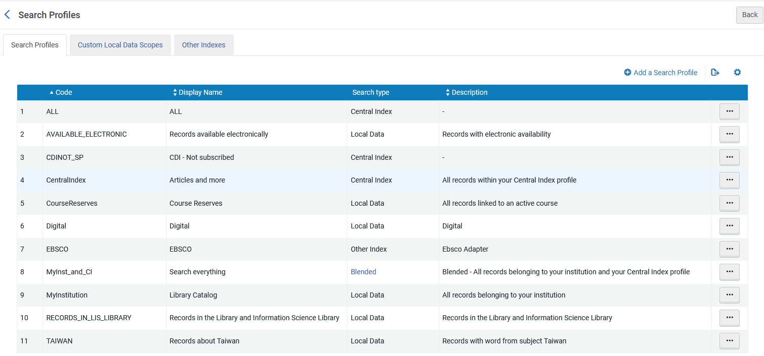
Configuring a new search profile and search scope - example 3
The new search profile has been saved

Slide 52
Adding a search profile slot to a Primo View

Slide 53
Adding a search profile slot to a Primo View
We will now add the following new search profile slots which we just created to the Primo View called “Alma”.
The three new search profile slots which we will add are:
Records about Taiwan
Records available electronically
Records in the Library and Information Science Library

Slide 54
Adding a search profile slot to a Primo View – example 1

Slide 55
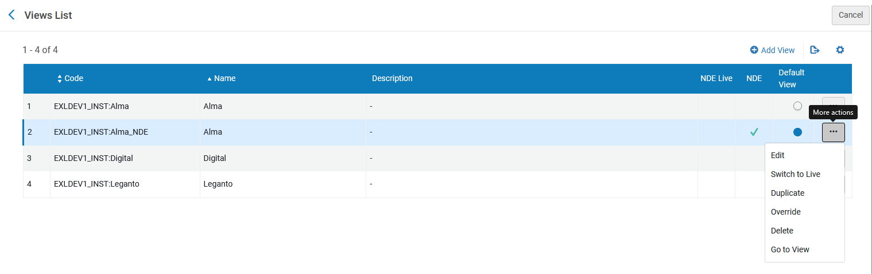
Adding a search profile slot to a Primo View – Example 1
To add a search profile slot to a Primo View:
On the Views List page (Configuration Menu > Discovery > Display Configuration > Configure Views), edit the view.

Slide 56
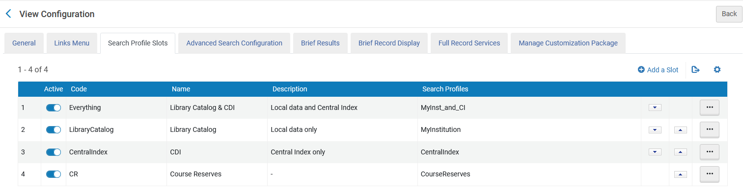
Adding a search profile slot to a Primo View – Example 1
Select the Search Profile Slots tab.

Slide 57
Adding a search profile slot to a Primo View – Example 1
Select “Add a Slot” to open the Define Slot Page.

Slide 58
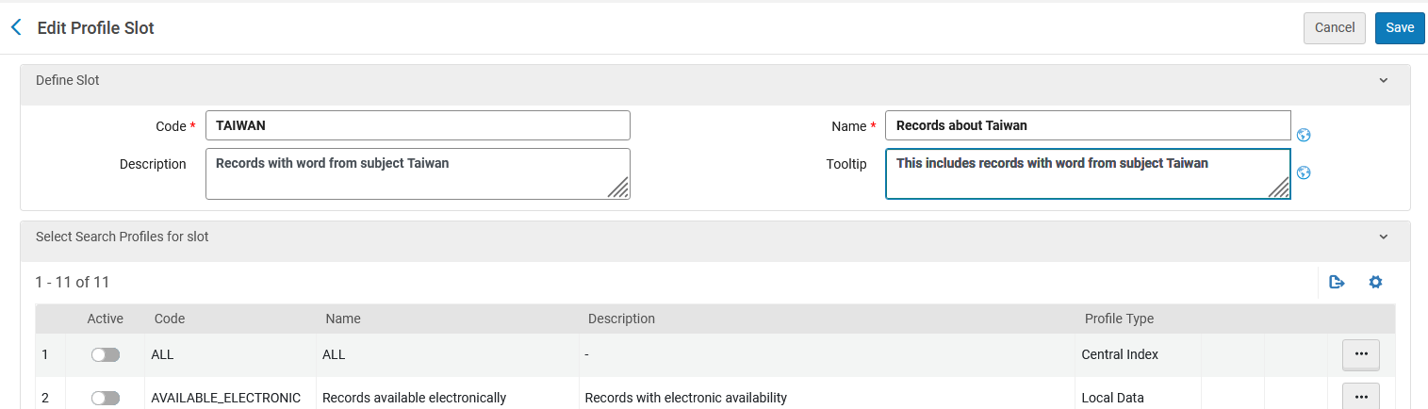
Adding a search profile slot to a Primo View – Example 1
In the “Define Slot” section define the Code, Name and optional other fields.
Specify a unique code for this slot.
Optional text to describe the slot.
Specify a unique name for this slot.
Specify the tooltip for this slot, which appears only in the Advanced Search window.

Slide 59
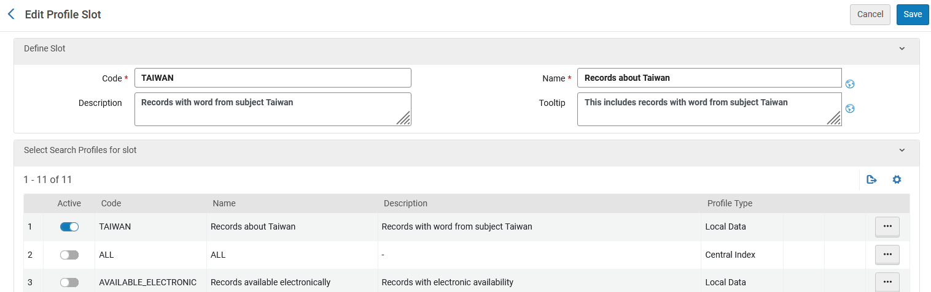
Adding a search profile slot to a Primo View – Example 1
In the “Select Search Profiles for slot” section activate the search profiles which are desired to be in the new search profile slot.
Activate the desired search profiles for the search profile slot.

Slide 60
Adding a search profile slot to a Primo View – Example 1
Save the profile slot.

Slide 61
Adding a search profile slot to a Primo View – example 2

Slide 62
Adding a search profile slot to a Primo View – Example 2
To add a search profile slot to a Primo View:
On the Views List page (Configuration Menu > Discovery > Display Configuration > Configure Views), edit the view.

Slide 63
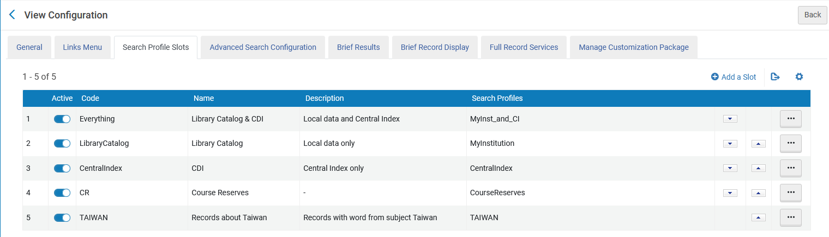
Adding a search profile slot to a Primo View – example 2
Select the Search Profile Slots tab.

Slide 64
Adding a search profile slot to a Primo View – example 2
Select “Add a Slot” to open the Define Slot Page.

Slide 65
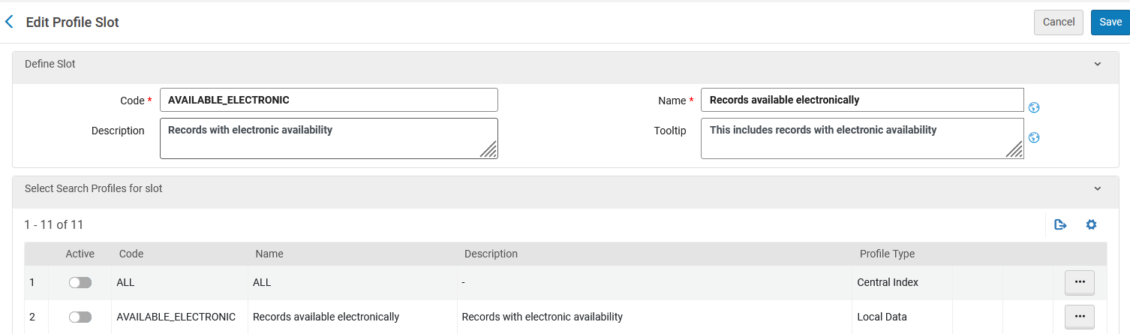
Adding a search profile slot to a Primo View – example 2
In the “Define Slot” section define the Code, Name and optional other fields.
Specify a unique code for this slot.
Optional text to describe the slot.
Specify a unique name for this slot.
Specify the tooltip for this slot, which appears only in the Advanced Search window.

Slide 66
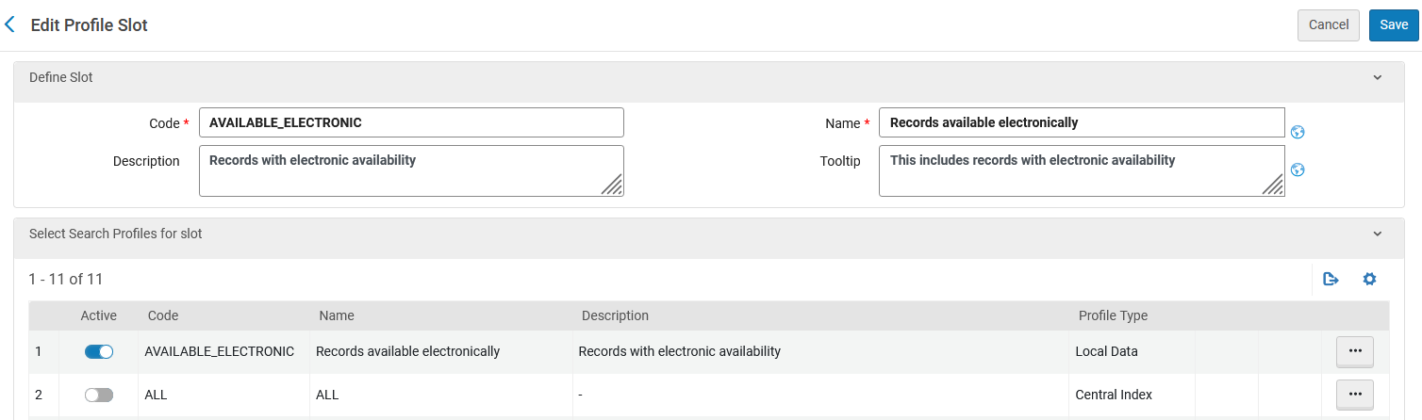
Adding a search profile slot to a Primo View – example 2
In the “Select Search Profiles for slot” section activate the search profiles which are desired to be in the new search profile slot.
Activate the desired search profiles for the search profile slot.

Slide 67
Adding a search profile slot to a Primo View – example 2
Save the profile slot.

Slide 68
Adding a search profile slot to a Primo View – example 3

Slide 69
Adding a search profile slot to a Primo View – Example 3
To add a search profile slot to a Primo View:
On the Views List page (Configuration Menu > Discovery > Display Configuration > Configure Views), edit the view.

Slide 70
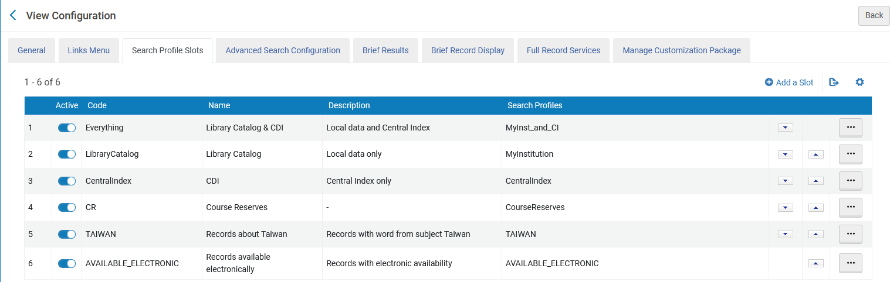
Adding a search profile slot to a Primo View – example 3
Select the Search Profile Slots tab.

Slide 71
Adding a search profile slot to a Primo View – example 3
Select “Add a Slot” to open the Define Slot Page.

Slide 72
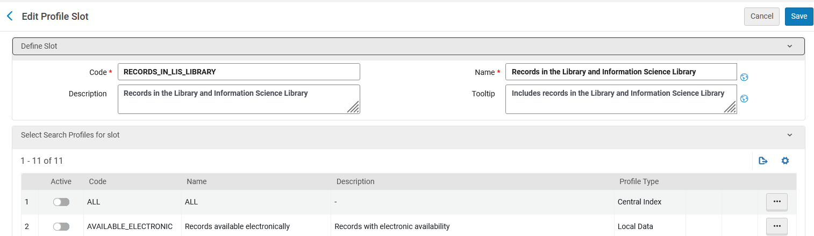
Adding a search profile slot to a Primo View – example 3
In the “Define Slot” section define the Code, Name and optional other fields.
Specify a unique code for this slot.
Optional text to describe the slot.
Specify a unique name for this slot.
Specify the tooltip for this slot, which appears only in the Advanced Search window.

Slide 73
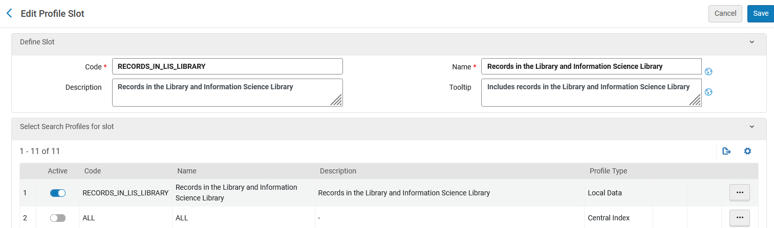
Adding a search profile slot to a Primo View – example 3
In the “Select Search Profiles for slot” section activate the search profiles which are desired to be in the new search profile slot.
Activate the desired search profiles for the search profile slot.

Slide 74
Testing the new search profile slots

Slide 75
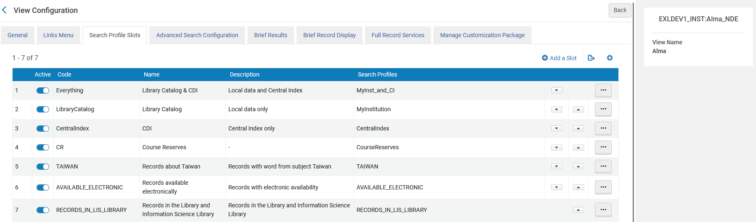
Testing the new search profile slots
All new search profile slots have been added to the Primo view called “Alma”

Slide 76
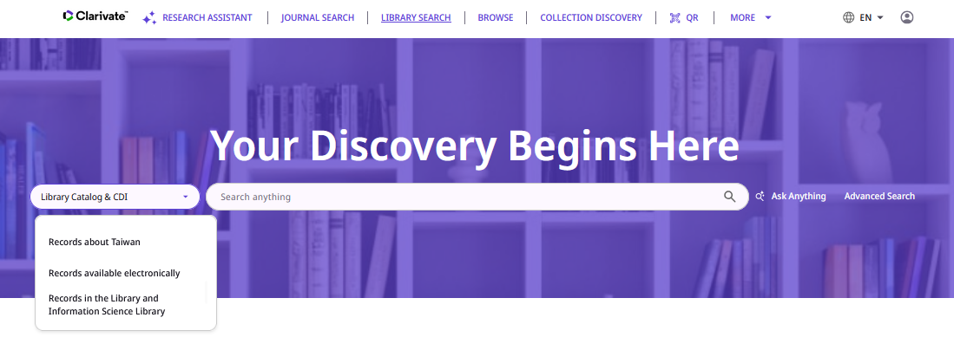
Testing the new search profile slots
All new search profile slots have been added to the Primo view called “Alma”

Slide 77
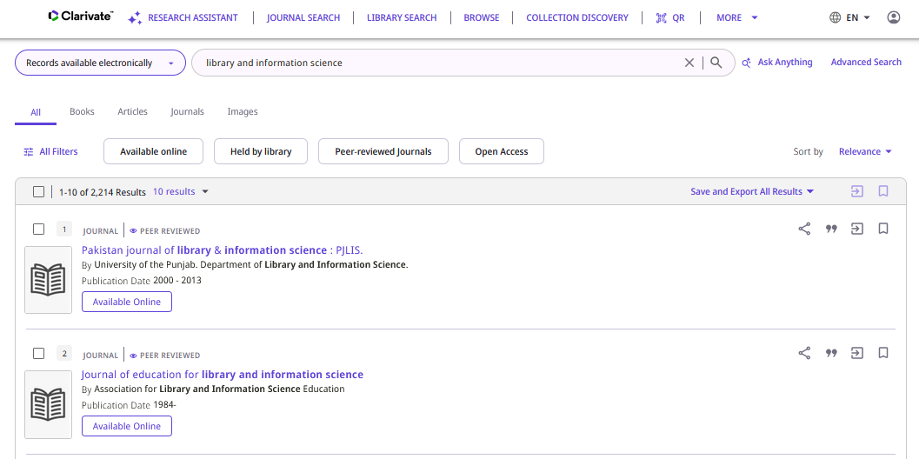
Testing the new search profile slots
If we search the profile slot “Records available electronically” then all records are “Available Online”
The new search profile slot works correctly

Slide 78
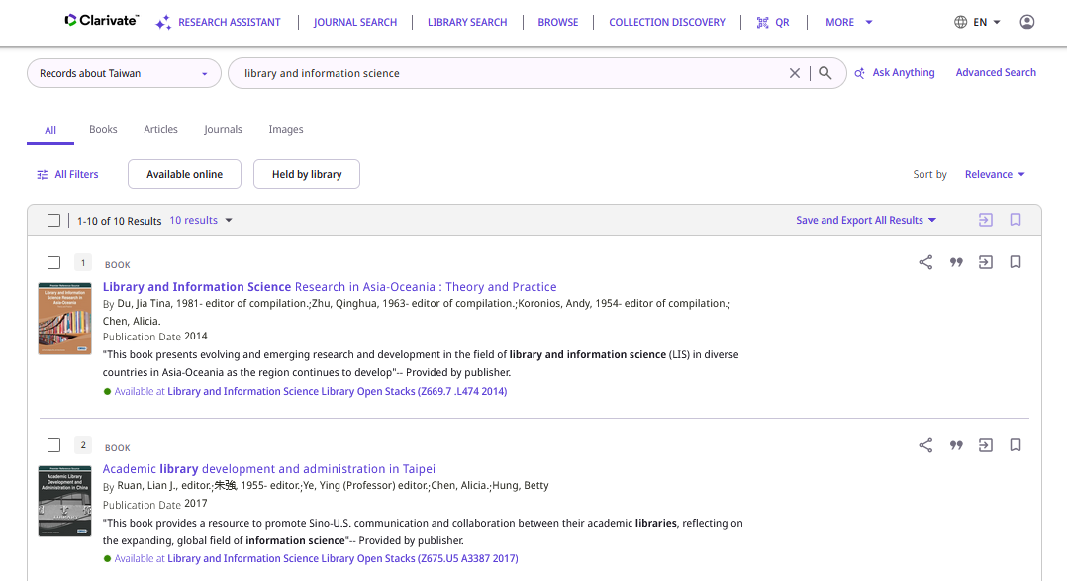
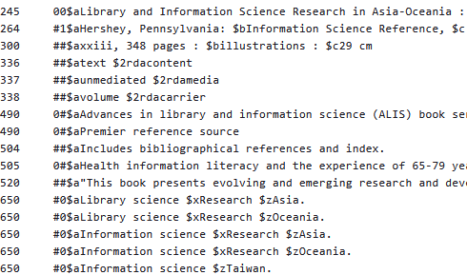
Testing the new search profile slots
If we search the profile slot “Records about Taiwan” then all records have word from subject “Taiwan”
The new search profile slot works correctly

Slide 79
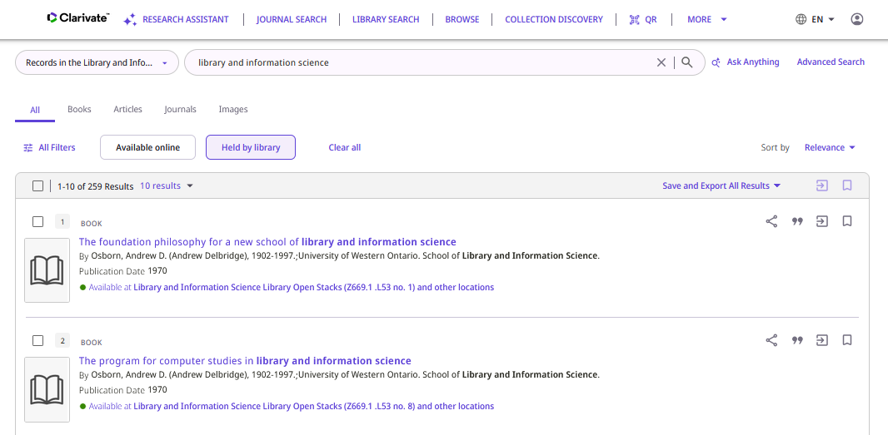
Testing the new search profile slots
If we search the profile slot “Records in the Library and Information Science Library” then all records are in the Library and Information Science Library
The new search profile slot works correctly

Slide 80
Thank You

